Slide 1



Slide 2
Clinical genomics and the need for speed…
…and scalability, portability, reproducibility, interpretability

Slide 3


Clinical genomics
We’re working on humans
High accuracy required for clinical use
More data available
Pipelines are generalised

Slide 4
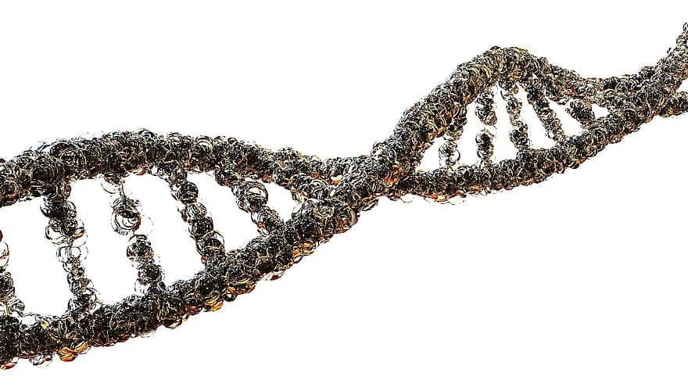
Clinical genomics
What is clinical genomics?
Clinical genomics as of 2020
Rapid advances in genomic technology
Reduced cost of sequencing
Uptake of genomic technology
“Genomic technologies are reaching the point of being able to detect genetic variation in patients at high accuracy and reduced cost, offering the promise of fundamentally altering medicine”
Katsanis & Katsanis, Nature Reviews Genetics, 2013

Slide 5
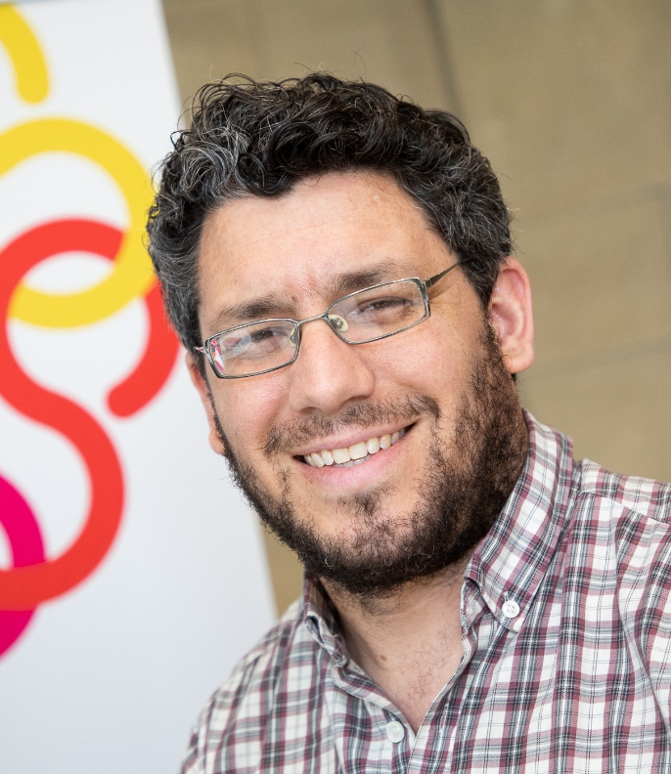

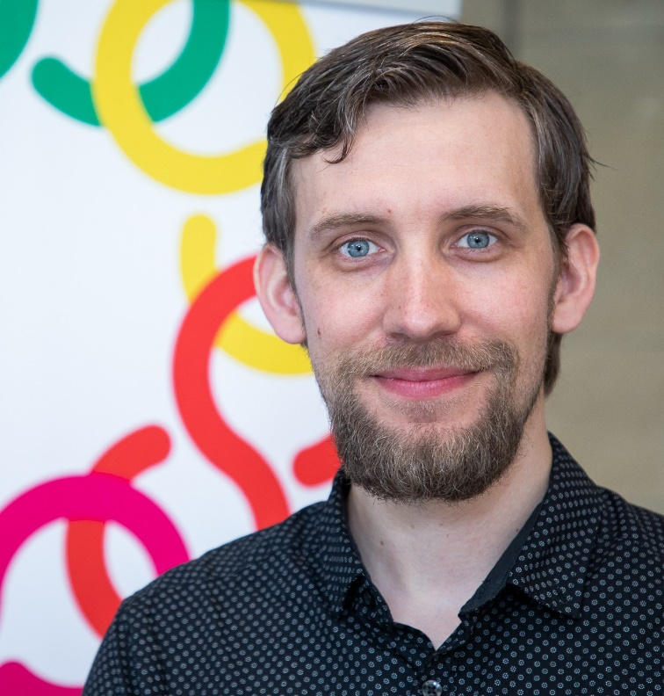
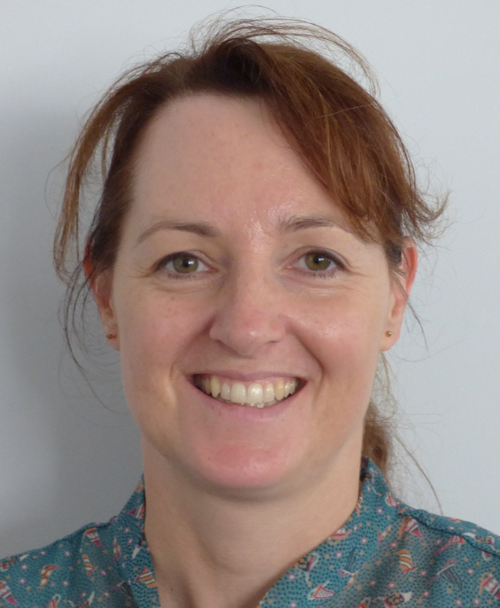

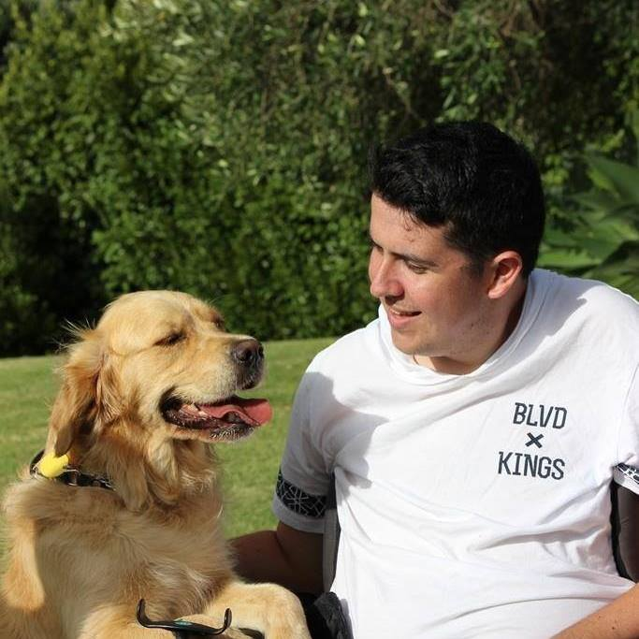
Our people, projects and research
Human genomics team
Miles Benton
Senior Scientist Bioinformatics
Bioinformatics Leadership Team (Health) - Genomics Aotearoa
Donia Macartney-Coxson
Human Genomics Science Leader
Rakeiora Leadership Team - Genomics Aotearoa
Joep de Ligt
Technical Lead Bioinformatics
Science Leadership Team – Genomics Aotearoa
Jane Clapham
Senior Laboratory Technician
Alessandra Santana
PhD student
Nathan Russell
PhD student

Slide 6
Our people, projects and research
Independent research
Clinical diagnostics through genetics
Contract(s) with CCDHB Wellington Regional Genetics Lab
Providing support to CCDHB for Clinical Genomics GA project (Stephen Robertson)
Clinical research, in collaboration with local clinician (Richard Carroll) - hyperparathyroidism
Sequencing 100 exomes
Engaging clinicians from other DHBs
Exploring the replacement of gene panels with exome/genome

Slide 7






My work
Sample collection
Clinical interpretation
Patient treatment
Transit
Sequencing
Bioinformatics
Overhaul pipelines
Implement user interface for clinicians to explore data (scout)

Slide 8
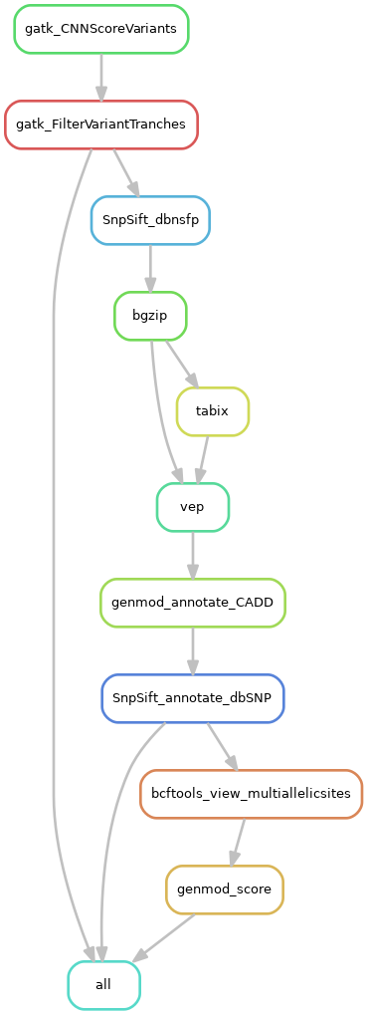
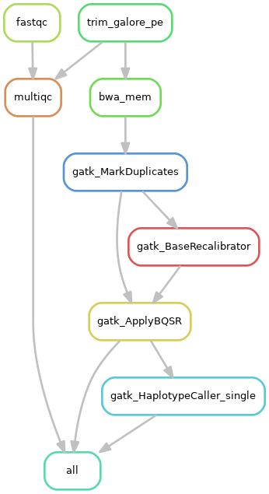
Pipelines
https://github.com/ESR-NZ/human_genomics_pipeline/
Process paired-end sequencing data
Fastq to vcf
Quality control checks
https://github.com/ESR-NZ/vcf_annotation_pipeline/
Filter variant calls
Annotate vcfs
Prepare to ingest into scout

Slide 9
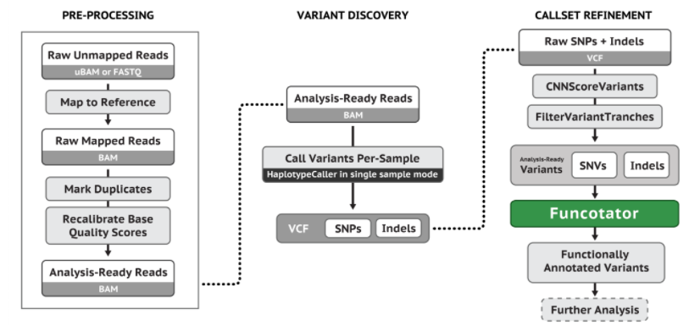
Pipelines
GATK best practice

Slide 10
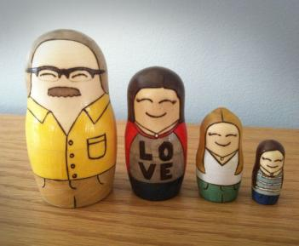
Pipelines
Singletons
Cohorts

Slide 11
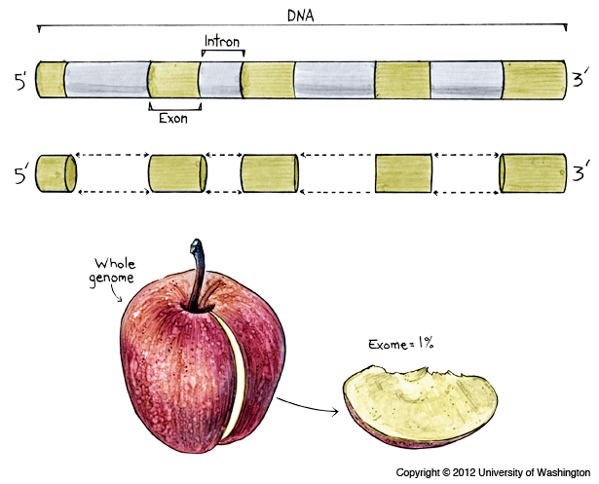
Pipelines
WES and WGS analysis

Slide 12
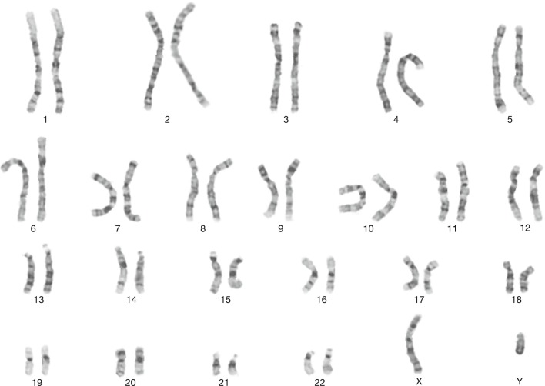
Pipelines
Choice of reference genome
b37
hg38
Other species

Slide 13

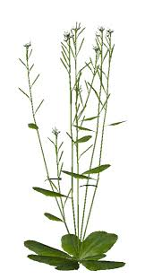



Pipelines
Species agnostic

Slide 14
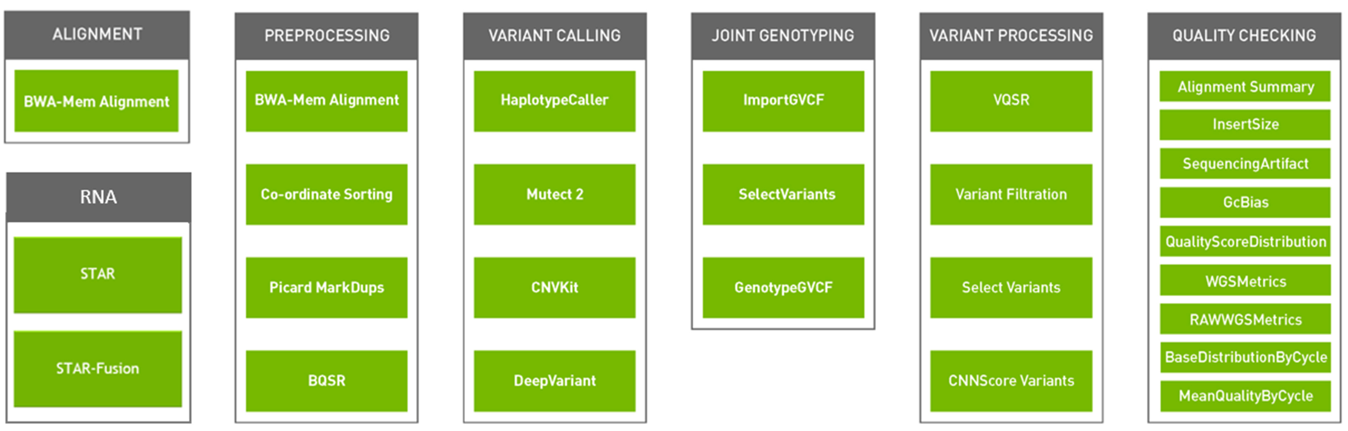
Pipelines
Identical cpu and gpu runs

Slide 15

Speed
Why?
Clinical decision making
Information is power

Slide 16
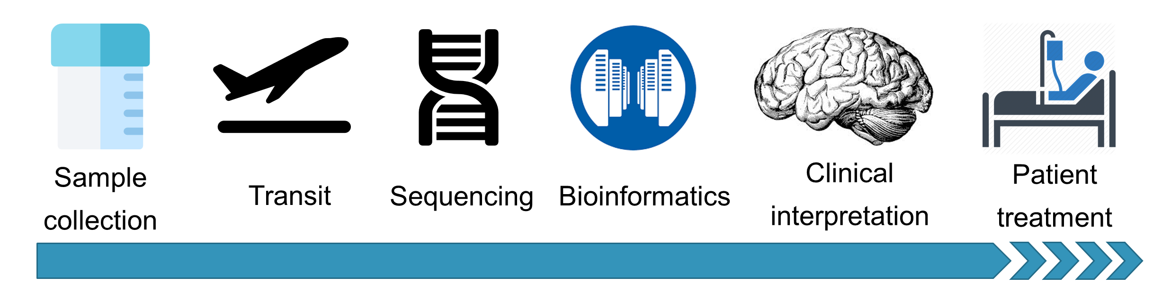
Speed
How?
Transit/sequencing
Sequencing capacity in New Zealand
Fewer genetic tests ordered
Times
Offshore ~ months
Onshore ~ hours/days?

Slide 17
Speed
How?
Automation - pipelines

Slide 18
Speed
How?
Bioinformatics
HPC
GPUS + NVIDIA clara parabricks pipelines
Times
100X exome – CPC ~ 8-12 hours
100X exome – GPU ~ 6-12 mins
30X genome – CPU ~ 30-48 hours
30X genome – GPU ~ 4 hours

Slide 19

Scalability
Why?
Treat more patients
Reduce costs
How?
Snakemake
“Snakemake is a little like your favourite childhood game”

Slide 20
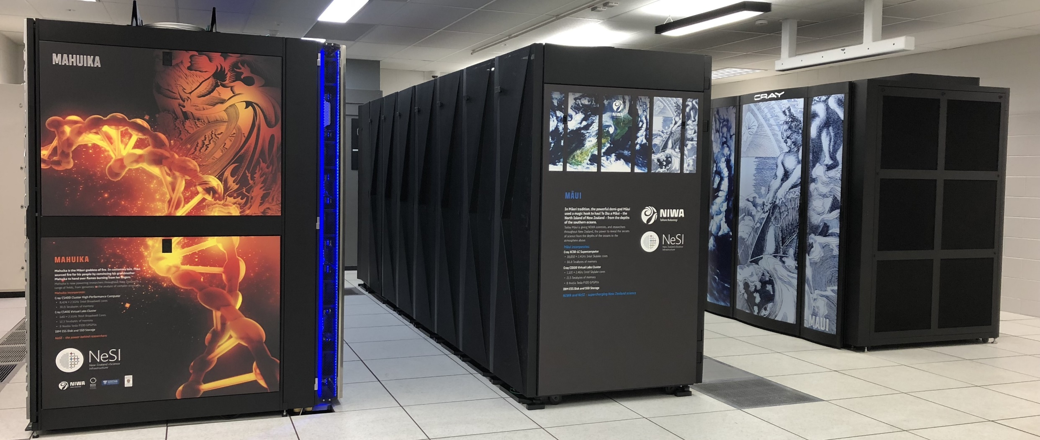

Scalability
How?
HPC
Integration with workflow schedulers (like SLURM)
“New Zealand eScience Infrastructure (NeSI)”

Slide 21
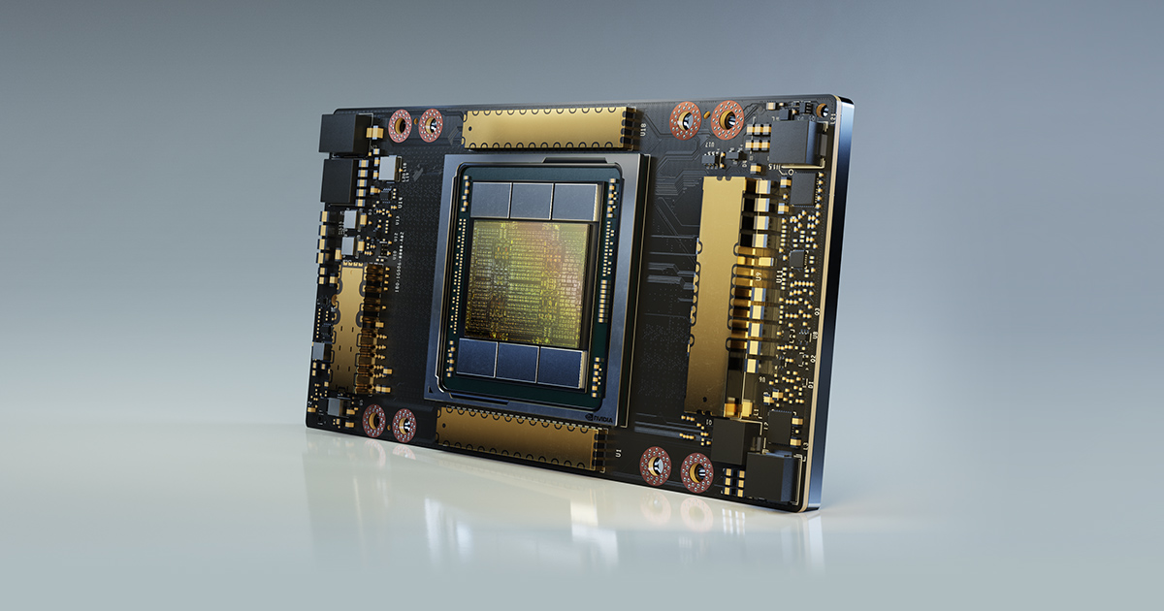
Scalability
How?
GPUs
Further development of NVIDIA clara parabricks
“NVIDIA A100”

Slide 22

Portability
Why?
Save the world from headaches
Supports speed, reproducibility, scalability

Slide 23
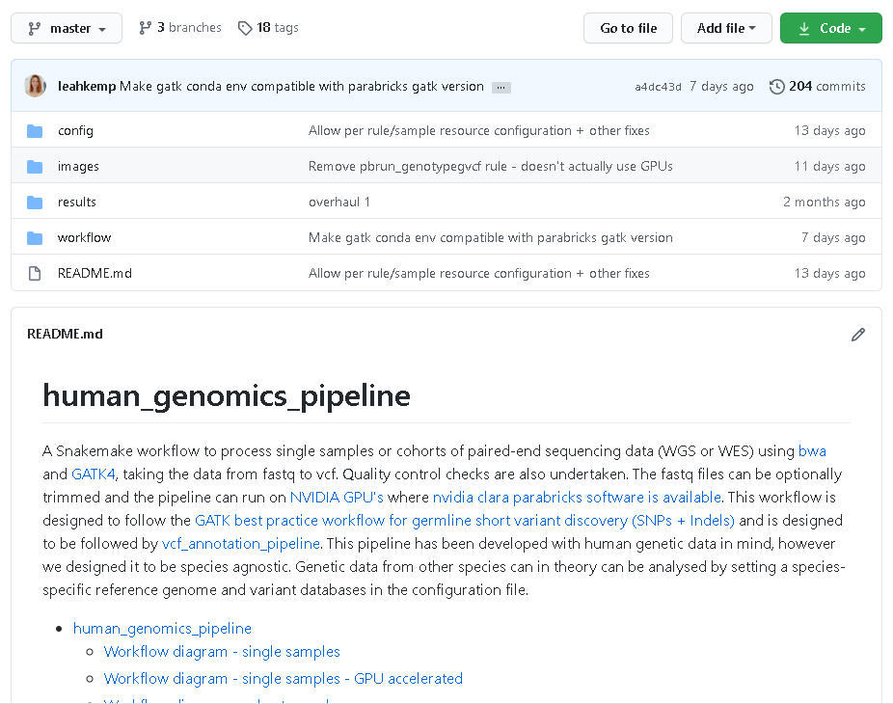


Portability
How?
Open source

Slide 24



Portability
How?
Minimal software install

Slide 25

Portability
How?
The power of …
snakemake + conda envs/singularity containers

Slide 26
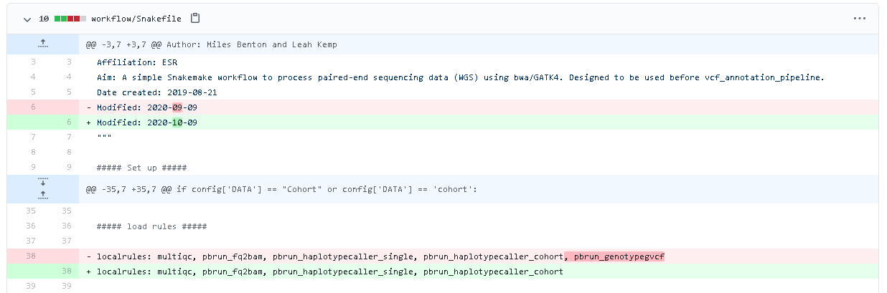
Reproducibility
Why?
Why not?
How?
Open source
Github - version tracking

Slide 27
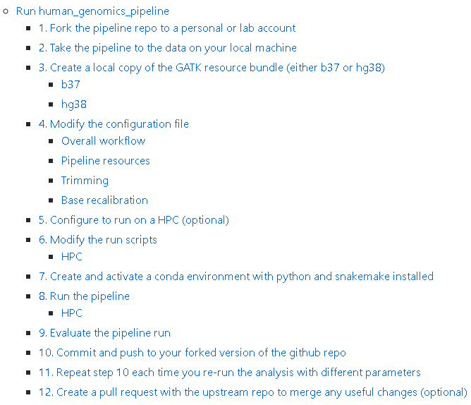
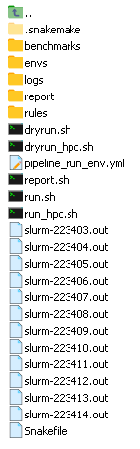
Reproducibility
How?
Documentation
Logging
Interactive reports

Slide 28

Interpretability
Why?
Clinical decision making
Too much data!
How?
Scout
“https://github.com/Clinical-Genomics/scout”

Slide 29
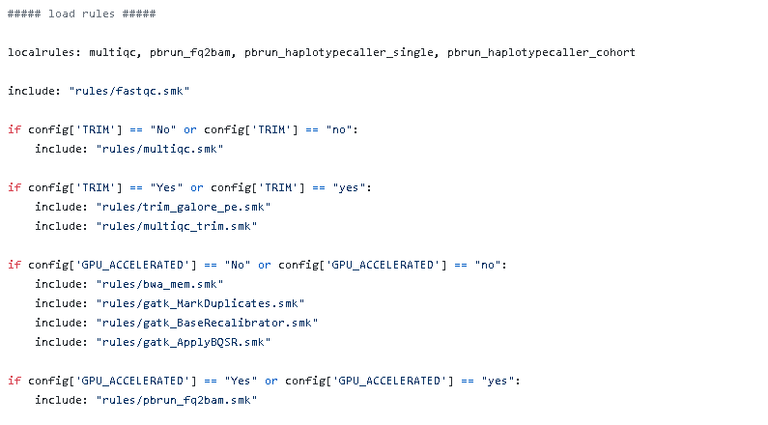
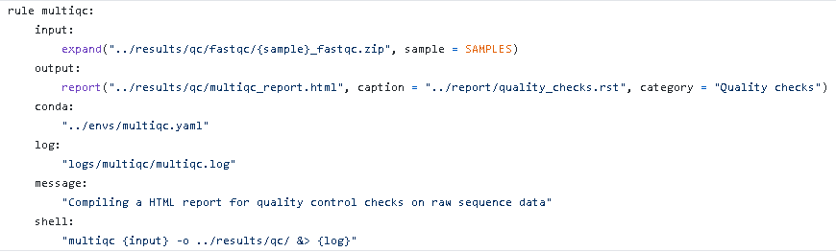
Interpretability
Why?
Collaborative pipeline development
How?
Workflow language
Documentation

Slide 30
Wider context
Somatic analysis (Chris Print and Ben Curren)
https://www.genomics-aotearoa.org.nz/projects/genomic-translational-oncology
https://www.genomics-aotearoa.org.nz/projects/rakeiora-pathfinder-genomic-medicine

Slide 31
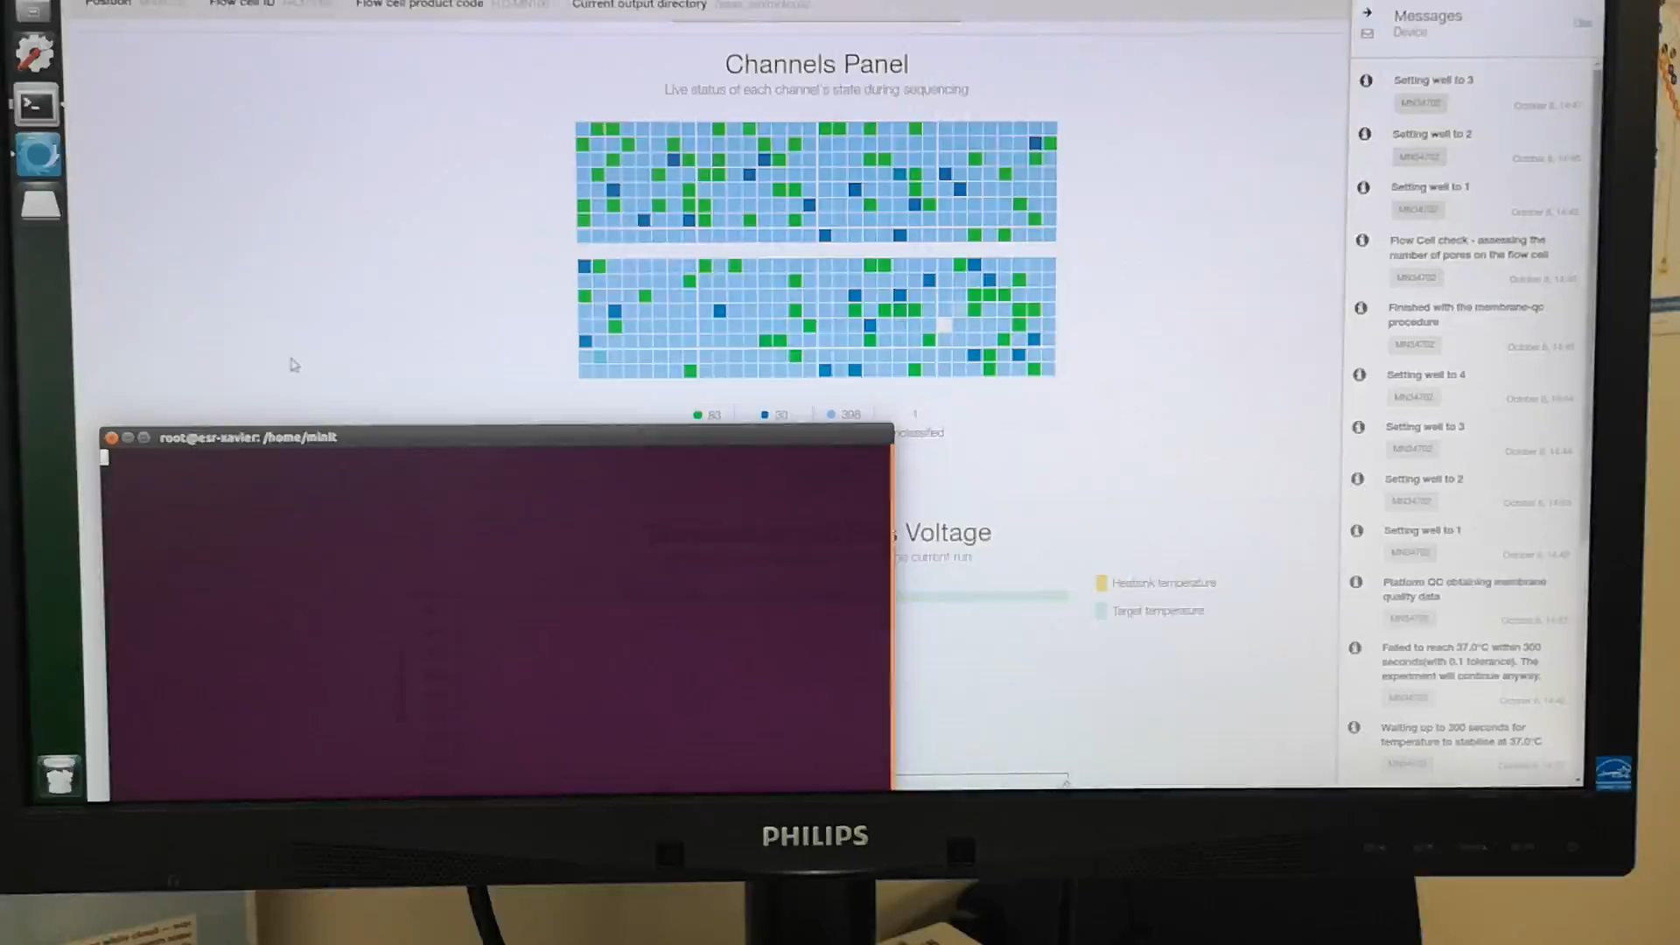
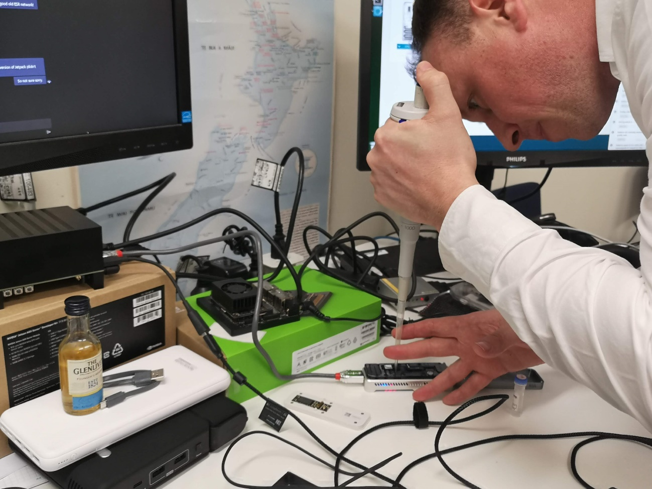
Wider context
Portable sequencing
https://github.com/sirselim/jetson_nanopore_sequencing

Slide 32
Where to from here?
Where we are
We’ve developed GATK best practice, species agnostic, pipelines for analyzing single samples or cohorts of WES/WGS data
Where we want to go
Conversations
Share resources
Standardisation
We need you!
- Community collaboration
“A nationwide network, shared best practice and a joint infrastructure will therefore improve New Zealand’s bioinformatics capability” – Genomics Aotearoa

Slide 33

How to get started with the pipelines?
Fork repo’s
Test data
https://ftp-trace.ncbi.nih.gov/ReferenceSamples/giab/data/NA12878/Garvan_NA12878_HG001_HiSeq_Exome
Contribute back!
Bugs
Feature requests
Developments

